Slide 1
Artificial intelligence VIII
Maria Markosova

Slide 2
Last lecture
Analysis of the periodical changings – multiple box plot, triple exponential smoothing, autocorrelation coefficient
Power spectrum of the time series

Slide 3
Outline
Stationary time series
Box – Jenkins modelling
AR model
MA model ARMA model
Fitting the coefficients of the AR model, lag operators
Seeking for a good model of the measured time series.
Estimating model quality.
Nonlinear time series, short insight.

Slide 4
Stationary time series (stacionárny časový rad)
Definition: Time series is called stationary if it has folowing properties:
Finite variation
Constant average value
Autocorelation function independent on t, h, dependend only on (t-h).
variation
average value
- autocorrelation function

Slide 5
Importance of the time series stationarity
All of the modern methods of the time series elaboration and analysis are working with the stationary time series.
Modern theory of the time series is about stationary time series.
3.. Commercial software often demands that the time series is stationary.
All of this means, we need a methods by which it is possible to make the time series stationary.

Slide 6
Examples of stationary and non stationary time series
Random walk:
Distance of the random walk from the beginning is , let =0. :
Let , where are independent steps with average value zero
and variation .
Then the autocorrelation function is:
Time series is not stationary

Slide 7
Time series with linear trend
Time series behaves like this
Average
This time series is not stationary, because the average value is time dependent.
That means, if the the average value of the time series is calculated from the data to the time t, it is different to the average calculated from the data to the time t+delta t.

Slide 8
White noise
White noise has a normal distribution with zero-th average value and variation . Autocorrelation function of the white noise is if h=0 and 0 elsewhere.
White noise creates a stationary time series.

Slide 9
How to make the time series stationary?
There are several more or less heuristic methods.
If the series has a significant trend, find it and subtract the trend values from the series values. Check, whether the series is stationary.
If the trend is not significant enough, to remove it often helps to make the first difference of the time series.
From the series
create a new series
$$x_{2}−x_{1}$$

Slide 10
If the first difference does not remove the trend make a second difference
If we are successful in removing the trend, find the time series period and subtract the regular periodic changes from the time series values. For example by making a transformation :
To make the time series stationary is often problematic. But the good news is, the commercial software usually does the job for you.
If none of the previous methods are successful there are some more heuristic rules, which usually do the job,

Slide 11
Heuristic rules
If the time series has a trend and variation and both depend on time, make a logarithm of the time series values.
If there is no trend and variation is time dependent, logarithm of the time series values is not enough to make the series stationary .
Logarithm can help, if there is a trend and periodicity and the amplitude of the periodic changes is proportional to the time dependent average value (multiplicative periodicity).

Slide 12
How to create a time series model by the Box-Jenkins method
Box –Jenkins method is a method of fitting the time series and creating a model of the time series based on the time series past values. It is a classical method named according two British statisticians George Box and Gwilym Jenkins.
Time series for the BJ analysis must be stationary
Advantages of the BJ method:
a) models are adaptive, and thus widely usable
b) there are a good programs elaborated using BJ modeling of the time series
BJ method works with random parts of the time series, which can be correlated
Disadvantages:
For the complete ARMA model the length of the series have to be at least 50 measurement points (this can be complicated in a long term measurements done for example once a year).
b) Difficult interpretation of the model.

Slide 13
Autoregressive model (AR model)
It is a linear regression of the actual value of the time series against several previous values. AR model works only for the stationary series.
- series values
p- model order
- White Gaussian noise
,
- average value of , if the model is more simple

Slide 14
Simplified AR model, if the average value is zero:
AR model of the first order:
AR model of the second order:

Slide 15
Fitting the coefficients of the AR model
There are several methods, each of which has its advantages and shortcomings:
with a help of the autocorrelation function solving a set of linear Yule – Walker equations
least square method (metódou najmenších štvorcov )
the best practical way is to leave the task to the commercial software which chooses the method leading to the smallest prediction error

Slide 16
AR model coefficient calculation by the least square method
Minimize:

Slide 17
This equation can be rewritten for the times from t up to t+p and into matrix form
Solution by the least square method:
Notes:
Linear least square riešenie pozri https://en.wikipedia.org/wiki/Linear_least_squares_(mathematics)

Slide 18
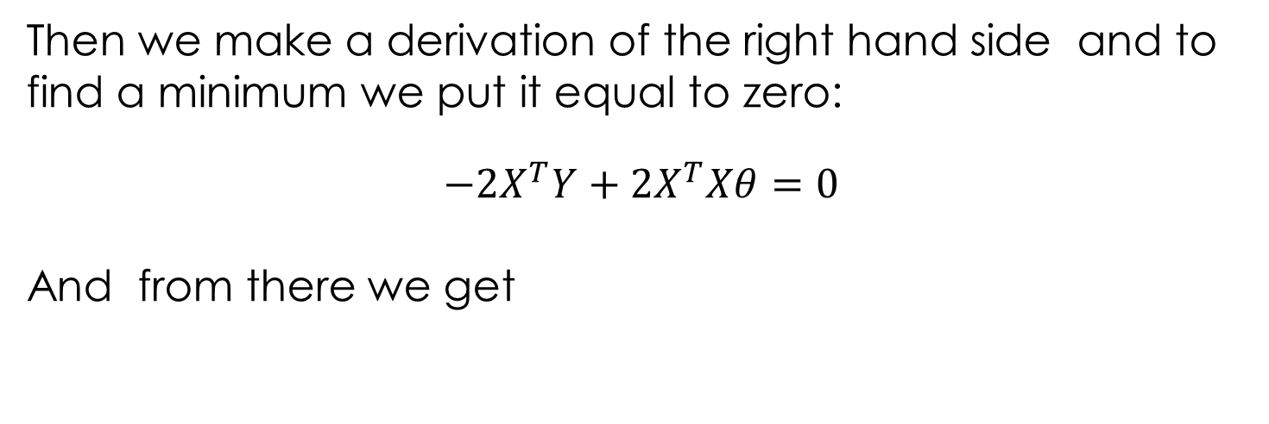
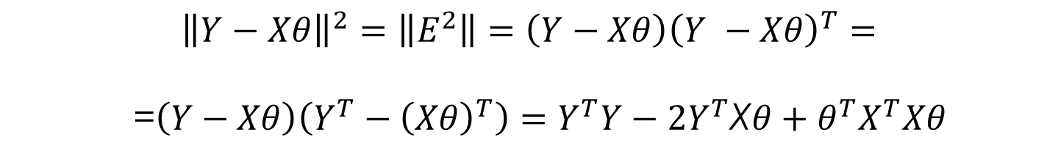
How to get the least square solution:
$${\left\|Y−Xθ\right\|}^{2}=\left\|E^{2}\right\|=\left(Y−Xθ\right){\left(Y −Xθ\right)}^{T}=$$
=$\left(Y−Xθ\right)\left(Y^{T}−{\left(Xθ\right)}^{T}\right)=Y^{T}Y−2Y^{T}$X$θ+θ^{T}X^{T}Xθ$
Then we make a derivation of the right hand side and to find a minimum we put it equal to zero:
$$−2X^{T}Y+2X^{T}Xθ=0$$
And from there we get
We used the relations ${\left(Xθ\right)}^{T}=θ^{T}X^{T}, θ^{T}X^{T}Y=Y^{T}Xθ and{ \left(Y −Xθ\right)}^{T}=$
=$\left(Y^{T}−{\left(Xθ\right)}^{T}\right).$

Slide 19
Moving average model
Assumption: Random errors effect the next values of the time series
Advantage: A good model for the input – response processes, in which we know how output depends on the input, but we know nothing about random influences.
Great disadvantage: Calculation of the MA coefficients is not that straightforward as for the AR model. It is a nonlinear iterative process. Rely on the commercial software in practical usage.

Slide 20
Moving average model (MA model)
-time series values
- white noise
- model parameters, coefficients
- model order
This is in fact a linear regression of the actual series value against errors influencing past series values

Slide 21
Simplified MA model:
MA first order model:
MA second order model:

Slide 22
Lag operator (operator posuvu)
Let us introduce lag operator L: L is distributive with respect to the
additive operator:

Slide 23
How to rewrite AR and MA model using lag operator L
AR(1)
AR(p)
MA(1)
MA(q)
Let us introduce lag polynoms:

Slide 24
General expressions for AR and MA models
In general, using lag polynomes AR and MA model can be expressed like this:

Slide 25
ARMA model (Box – Jenkins model)
ARMA combines both AR and MA model.
Assumption: Time series current value at the time t depends on the previous series values and also depends on previous random effects.

Slide 26
Box- Jenkinsov ARMA model
Combines AR and MA models.

Slide 27
Simplifies ARMA model:
If delta=0:
Expressing ARMA model with a help of the lag operatorr and lag polynoms:

Slide 28
Conditions for the successfull application of the ARMA model
Time series must be stationary, e.g. average value of the series, its variation and autocorrelation is not changing with time. That means the time series cannot have a trend and too pronounced seasonal changes.
Sometimas commercial software needs the time series with zero average value. To reach this, average value is subtracted from each value of the time series.
To the model seasonal AR and MA elements might be added. Modern Box Jenkins analysis enables this, but the fitting of the model is then far more complicated.

Slide 29
Creation of the ARMA model
The process of the model creation has the folowing three steps:
Model identification – what kind of model is appropriate for our time series, AR, MA or ARMA.
2. Parameter, coefficient estimates.
Model evaluation – estimation of the ability of the model to fit our time series, estimation to which extend the model is good.

Slide 30
Model identification
Check the stationarity of the series , find trend and seasonal components and make appropriate series transformations on the basis of your findings
If the series is stil not stationary, use the methods we have learned to make it stationary. Often in the praxix software does it automatically.
Find the order of the AR and MA elements of the series (p,q). To do it, make a dependance of the autocorrelation (ACF) and partial autocorrelation coefficients (PACF) on the time interval (ACF, PACF are also called AC function and PAC function). In the praxis software makes this automatically.
D) ARMA model with seasonal components is far more complex, we do not deal with this model here.

Slide 31
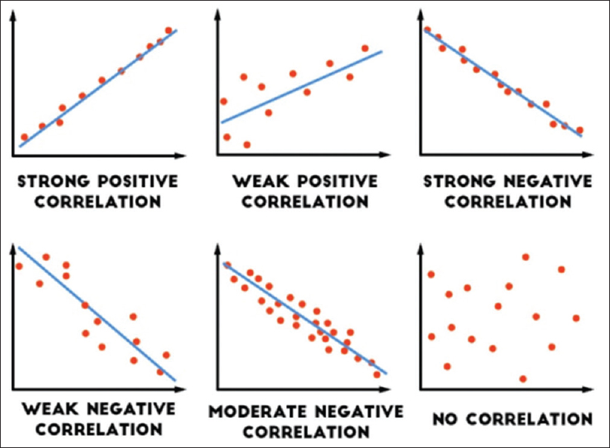
Autocorrelation and partial autocorrelation – intuitive insight
Notion of correlation
Correlation is a concept to show how well are the data linearly dependent.

Slide 32
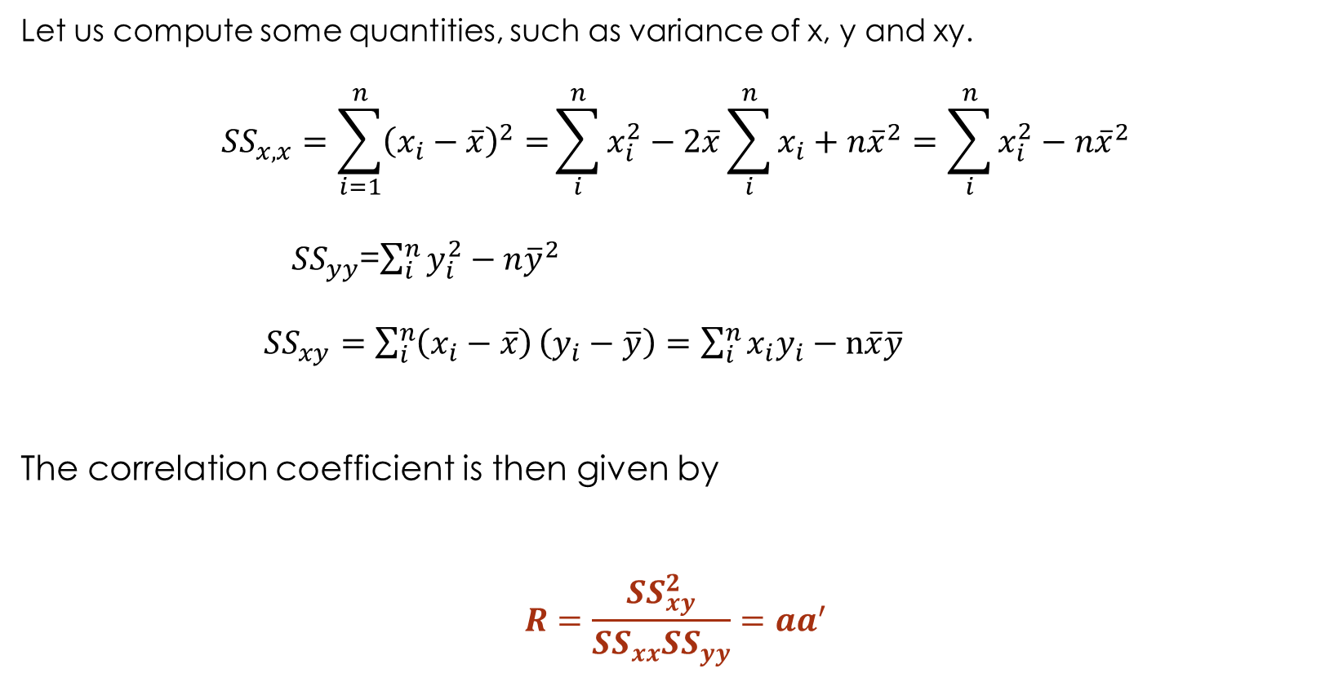
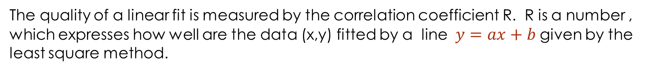
The quality of a linear fit is measured by the correlation coefficient R. R is a number , which expresses how well are the data (x,y) fitted by a line $y=ax+b$given by the least square method.
Let us compute some quantities, such as variance of x, y and xy.
$${SS}_{x,x}=\sum_{i=1}^{n}{{\left(x_{i}−\overline{x}\right)}^{2}=}\sum_{i}^{n}{x_{i}^{2}−2\overline{x}\sum_{i}^{n}{x_{i}+n{\overline{x}}^{2}=\sum_{i}^{n}{x_{i}^{2}−n{\overline{x}}^{2}}}}$$
${SS}_{yy}$=$\sum_{i}^{n}{y_{i}^{2}−n{\overline{y}}^{2}}$
${SS}_{xy}=\sum_{i}^{n}{\left(x_{i}−\overline{x}\right)}\left(y_{i}−\overline{y}\right)=\sum_{i}^{n}{x_{i}y_{i}}−n\overline{x}\overline{y}$
The correlation coefficient is then given by
$$R=\frac{{SS}_{xy}^{2}}{{SS}_{xx}{SS}_{yy}}=aa^{′}$$

Slide 33
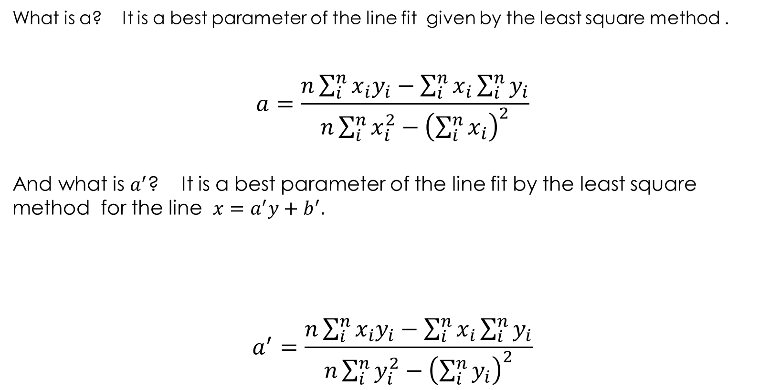
What is a? It is a best parameter of the line fit given by the least square method .
$$a=\frac{n\sum_{i}^{n}{x_{i}y_{i}−\sum_{i}^{n}{x_{i}}\sum_{i}^{n}{y_{i}}}}{n\sum_{i}^{n}{x_{i}^{2}−{\left(\sum_{i}^{n}{x_{i}}\right)}^{2}}}$$
And what is $a^{′}$? It is a best parameter of the line fit by the least square method for the line $x=a^{′}y+b^{′}.$
$$a^{′}=\frac{n\sum_{i}^{n}{x_{i}y_{i}−\sum_{i}^{n}{x_{i}}\sum_{i}^{n}{y_{i}}}}{n\sum_{i}^{n}{y_{i}^{2}−{\left(\sum_{i}^{n}{y_{i}}\right)}^{2}}}$$

Slide 34


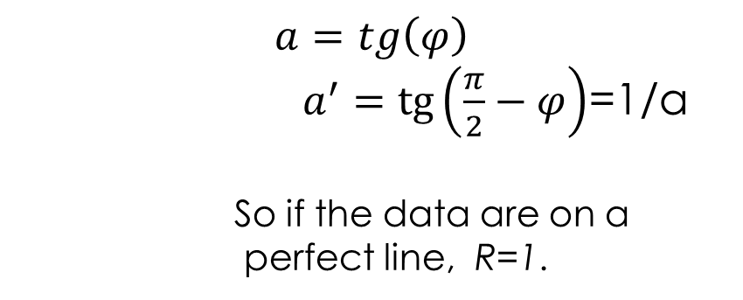
If the data are on a perfect line then :
$$\frac{π}{2}−φ$$
$$a=tg\left(φ\right)$$
$a^{′}=tg\left(\frac{π}{2}−φ\right)$=1/a
So if the data are on a
perfect line, R=1.
y
$$φ$$
x

Slide 35

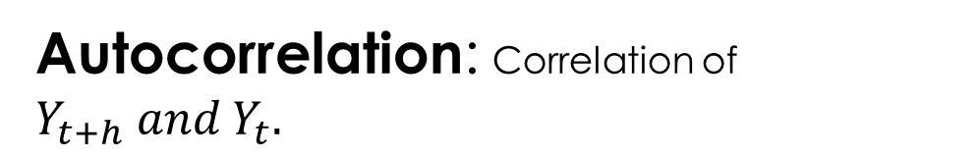

Autocorrelation: Correlation of $Y_{t+h} and Y_{t}.$
$$Y_{t+h}$$
$$Y_{t}$$
Autocorrelation describes whether the lagged data are linearly dependent and what is the quality of the least square fit. This quality is expressed in the autocorrelation coefficient, where on the y axis are lagged data.

Slide 36





Partial autocorrelation:
We fitted a line
$$Y_{t+h}$$
Correlation coefficient of this gives partial autocorrelation coefficient on the lag 2 which excludes the influence of lag 1.
$$Y_{t}$$
$${Residuals}_{t+h}$$
$${Residuals}_{t+h}$$
Residuals are numbers we get from measurement minus numbers from fit.
$$Y_{t}$$
$$Y_{t−h}$$

Slide 37
PACF – parcial autokocorrelation function calculation
To find PACF one need to calculate autocorrelation coefficient :
PACF removes the effect of autocorrelation on a smaller time lags h and its value is from the interval(-1,1).
PACF odstraňuje efekt autokorelácia na kratších časových posuvoch ako je h a pohybuje sa medzi hodnotami (-1,1).
Autocorrelation coefficient

Slide 38
How to calculate ACF?
1. Os y: autocorrelation coefficient ,
is the autokovariation funkction and
is the variation function
h=1,2,3,....,N, time lag

Slide 39
C) How to find a model order ( p, q)
I. Plot the dependance of the ACF on the time lag
II. Plot the dependance of the PACF on the time lag
For example:
ACF for the AR model is an exponentialy decreasing function.
PACF decreases to zero for the time intervel if the order of the model is p.
How to find where PACF is zero? Draw 95% confidence interval ( , N number of measurements).

Slide 40
Model identification on the basis of the ACF
How ACF looks
Suggested model
AR model, order of the model is found with a help of the PACF
Exp. decrease to zero
Alternation of the poz. and neg. values, still decreases to 0
--------------//---------------------
1 or several peaks, 0 elsewhere
MA model , order according ACF decrease to 0 (goes to 0 fot the lag q+1).
Decrease to zero after several time lags
ARMA model
Practically zero everywhere
Noncorrelated random dáta
No decrease to zero
Series is not stationary

Slide 41
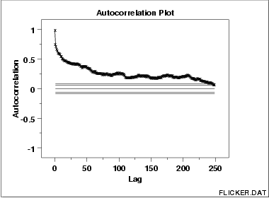
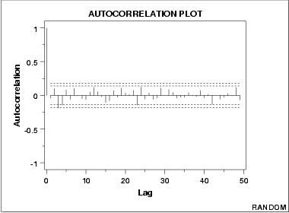
Autocorrelation function (ACF)
In this time series weak autocorrelation exists, so it is not a random series. y axis – autocorrelation coefficient. X axis: h – time lag. For this time series AR model is appropriate, the order of AR model is found with a help of PACF.

Slide 42
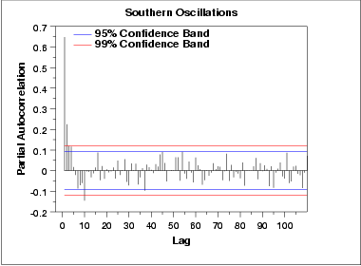
Parcial autocorrelation function (PACF)
This PACF shows, that the correlations for the time lag 1 and 2 are the most significant (at the zeroth time lag PACF always gives zero). Correlation at the time lag 3 is less significant. If the shape of ACF leads to the AR model, its order will be 2 or 3. Start with the order 2, add try also 3, whether the model is significantly better.

Slide 43
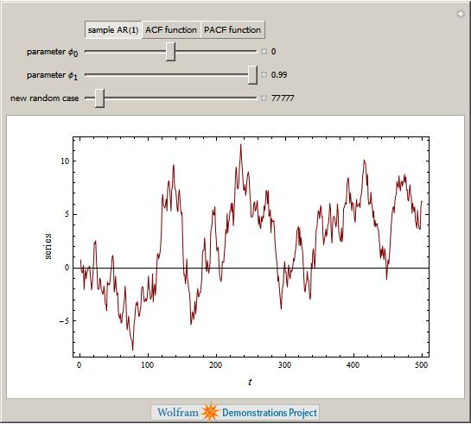
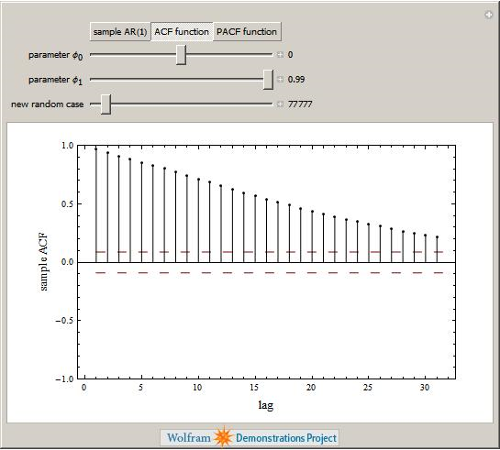
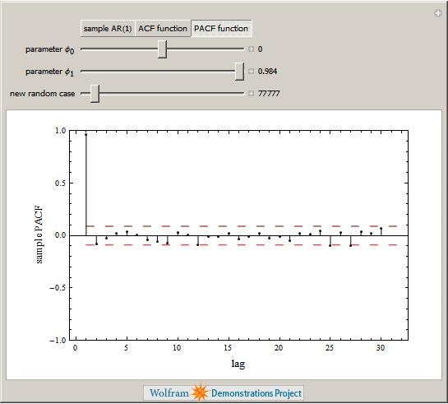
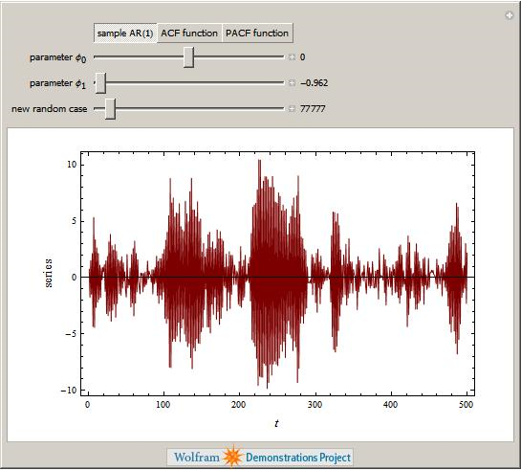
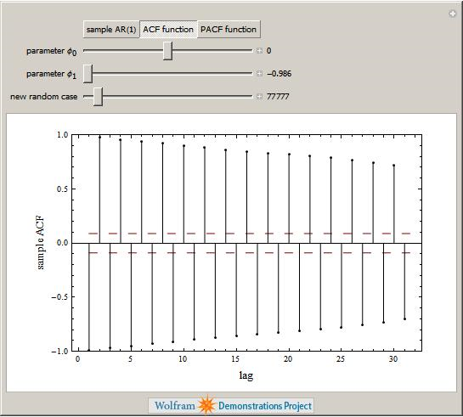
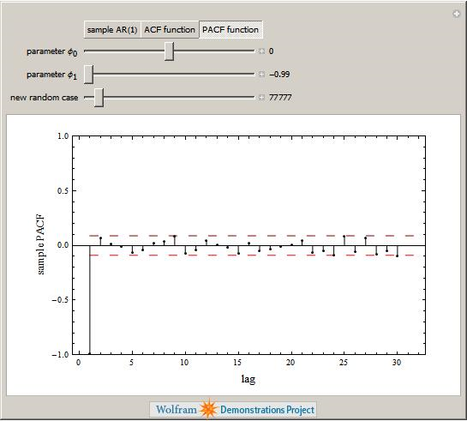
Time series ACF PACF

Slide 44
Model parameters (coefficients) estimate
Parameters estimate of the ARMA model is a complicated mathematical task. From the practical point of view, it is easier to rely on a good commercial software for the Box Jenkins time series analysis. For example Matlab has such software.
Model evaluation
Find residual elements , that means the difference of the real and fitted time series value at the given time.
For this residual time series draw ACF against time lags and check, whether it is practically zero. That means the residuals are independent from each other.
If yes, the current model is good, if no increase the model order or try a new model..

Slide 45
Forecasting based on the models
Having a model, usual task is to make a prediction about the next time development of the modeled series. To complete this task we need:
Control data for the forecast quality check. Usually part of the series data is used to build a model, and other part is used as a control dataset.
Measure, which evaluates the quality of the forecast (various error types)
Criterion, able to choose the best model from the suggested ones. This criterion needs to take into account fitting accuracy together with the model quality and complexity.
Training data
Control data
value
time

Slide 46
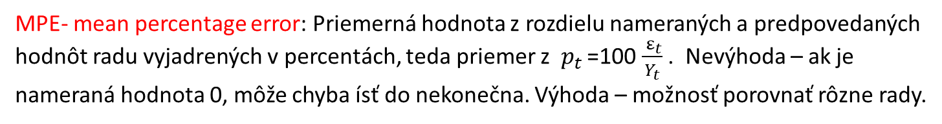
Forecasting quality evaluation
Errors which depend on the measurement, scale : Forecast error:
ME-mean error: Average from the forecast error values (average from values).
MPE- mean square error: Average from .
Using this error definitions, we cannot compare different type time series. Error depends on the number of values, on the measurement scale.
Errors expressed in percentage:
Average of these ratios expressed in percentage. Disadvantage: can grow to infinity if measurement is zero. Does not depend on scale, we can compare different time series. .

Slide 47

Errors independent on the measurement: Average value from
. This error is called MASE – Mean absolute scaled error.
This error enables one to compare different time series, without the danger that the error grows to infinity.

Slide 48
Akaike information criterion (AIC) .
Criterion, which chooses the best model from the possible models for the same dataset. This criterion evaluates the quality of the fit together with the model complexity. The best model has the lowest AIC value.
k –number of fitted parameters (for example coefficients in BJ models) , ss: sum of the quadratic errors.
n- number of measurements
Notes:
https://www.youtube.com/watch?v=YkD7ydzp9_E

Slide 49
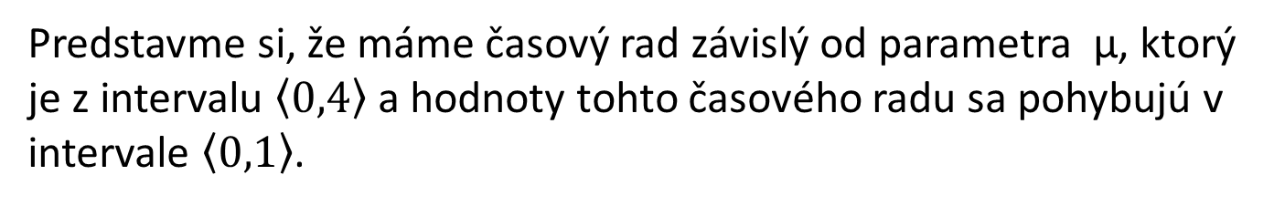


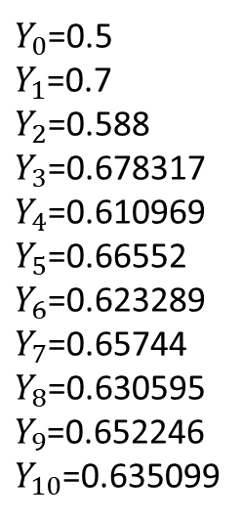
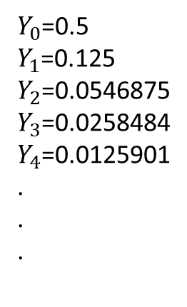
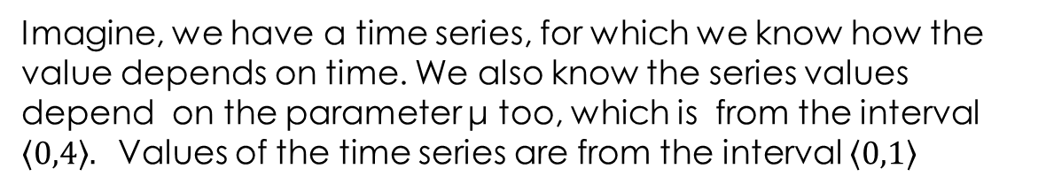
Nonlinear time series analysis - short insight
Imagine, we have a time series, for which we know how the value depends on time. We also know the series values depend on the parameter μ too, which is from the interval $\left\langle 0,4\right\rangle .$Values of the time series are from the interval $\left\langle 0,1\right\rangle$
For another interval of the μ values the time series values converge to the 2, 4 … values.
For certain interval of the parameter μ values the series converges to zero with time.

Slide 50
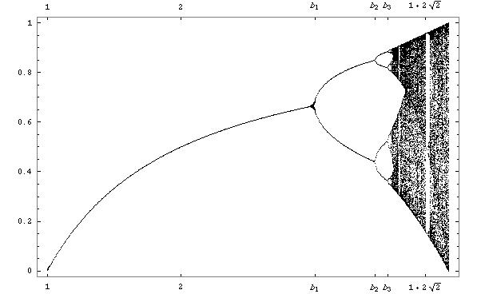
Dependency of the series values on the parameter μ for long times after convergence occurs.
Y
μ

Slide 51
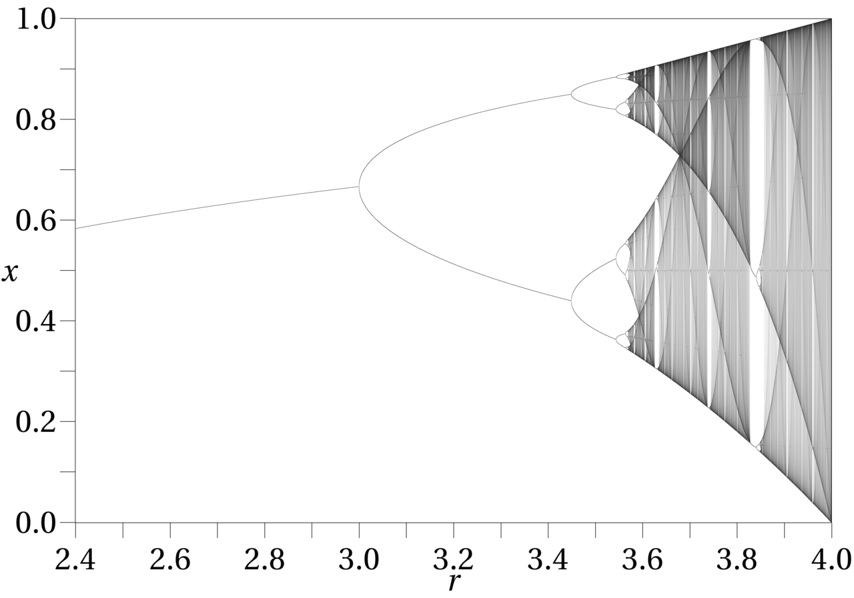
More detailed view:
Y
μ

Slide 52





What process creates such a complicated time series?
$$Y∈\left(0,1\right)$$
Time series equation.
F(Y)=μ(1-Y)
0
Y
0.5
1

Slide 53







μ is small, time series values converge to zero
1
0
0.5
1

Slide 54




As μ grows, time series values converge to certain limit.
1
0
0.5
1

Slide 55
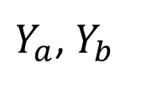
μ is even greater, time series values converge to the two values and the series displays periodic behavior. As the parameter grows, we have more complicated oeriodic, behavior , because the series values converge to 4, 8 …values.
1
0
Y
0.5
1

Slide 56


μ close to 4, time series values change chaotically.
1
0
0.5
1

Slide 57
What to remember?
In reality, the majority of the time series is created by nonlinear dynamical systems.
If we have a time series, whose behavior depends on some parameter changes, for each concrete parameter set the series can be elaborated with a help of the classical methods.
BUT! Remember, that the complex time series behavior can be caused by rather simple nonlinear iterative processes.
If there is such indication, change the conditions (parameters) for which the time series is measured and try to understand parameter dependence of the time series. Compare to the known nonlinear models.

Slide 58
Summary
How to make the time series stationary
AR, model – properties, parameter fitting via least square method.
MA model and lag operators.
ARMA model.
Identification of the model, autocorrelation and partial autocorrelation.
Criteria of the model quality.
Insight to the nonlinear time series.

Slide 59
How to get the least square solution:
$${\left\|Y−Xθ\right\|}^{2}=\left\|E^{2}\right\|=\left(Y−Xθ\right){\left(Y −Xθ\right)}^{T}=$$
=$\left(Y−Xθ\right)\left(Y^{T}−{\left(Xθ\right)}^{T}\right)=Y^{T}Y−2Y^{T}$X$θ+θ^{T}X^{T}Xθ$
Then we make a derivation of the right hand side and to find a minimum we put it equal to zero:
$$−2X^{T}Y+2X^{T}Xθ=0$$
And from there we get
We used the relations ${\left(Xθ\right)}^{T}=θ^{T}X^{T}, θ^{T}X^{T}Y=Y^{T}Xθ and{ \left(Y −Xθ\right)}^{T}=$
=$\left(Y^{T}−{\left(Xθ\right)}^{T}\right).$

